Slide 1

Certification
Management
App
Prepared for:
Salesforce Training Program
Capgemini Technology Services
Prepared by:
Apurv Taunk
Emp Id-46022707

Slide 2
Abstract:
The Certification Management System is a Salesforce based Application which is used for managing the certification of the employees of the organization. Two profiles use this application namely “App Admin” & “App User”. The App Admin produces the certifications and vouchers for the certification program and the App User connects with the employee for the certification program and generates a certification request in the application which is approved by the App Admin and a voucher is assigned to the certification request. Prior to the approval of the certification request, the App User updates the result of the certification exam given by the employee in the system. Apart from that, this application also has reports and dashboards to give and overall view of the system.

Slide 3
Objective:
This order management system is crucial in dealing with real time status of order after entry. This system helps in checking the latest update of the order and it also keep track of any fraudulent activity. This system has a capability to improve flow of work and communication with the vendors and customers.
The service industry can have a great boon with this system as they can see the real time sales by the help of reports and dashboards which could be cost effective. In this fast moving world, both B2B and B2C companies are choosing order management system to have a hustle free delivery for their customers.
Technology Used:
This project is built on salesforce.com. Customers and companies have become closer with better customer relation management through cloud-based technology. It is an integrated CRM platform, which provides a single view for every customer to all departments, which includes sales, marketing, service, commerce.

Slide 4
Scope:
Following is the functionality provided by Certification Management App:
There are 2 types of user in this app:
App User
App Admin
App User:
Manage Employee Records
Manage Certification Requests
Submit for approval
View/Edit Reports & Dashboards
Update Pass/Fail of certification request
App Admin:
Manage Certifications
Manage Vouchers
Approve/Reject Certification Requests
View/Edit Reports & Dashboards

Slide 5
Out Of Scope:
Following are the functionalities that are not covered by the system:
The application doesn’t include employee login.
The application is not autonomous.
There is no third party integrations involved except for email.
Functionalities done in Lightning Web Components (LWC):
List view of Employee records.
List view of Voucher records.
List view of Certification records.
List view of Certification Request records.
Employee record quick update on record detail page.

Slide 6
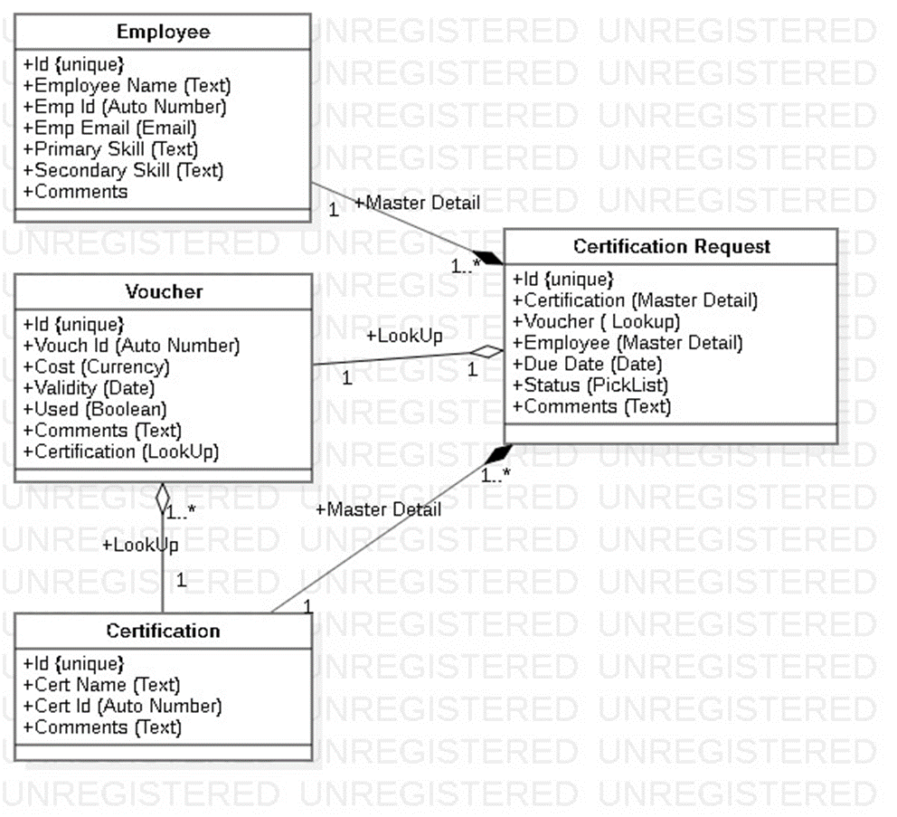
Class Diagram:

Slide 7
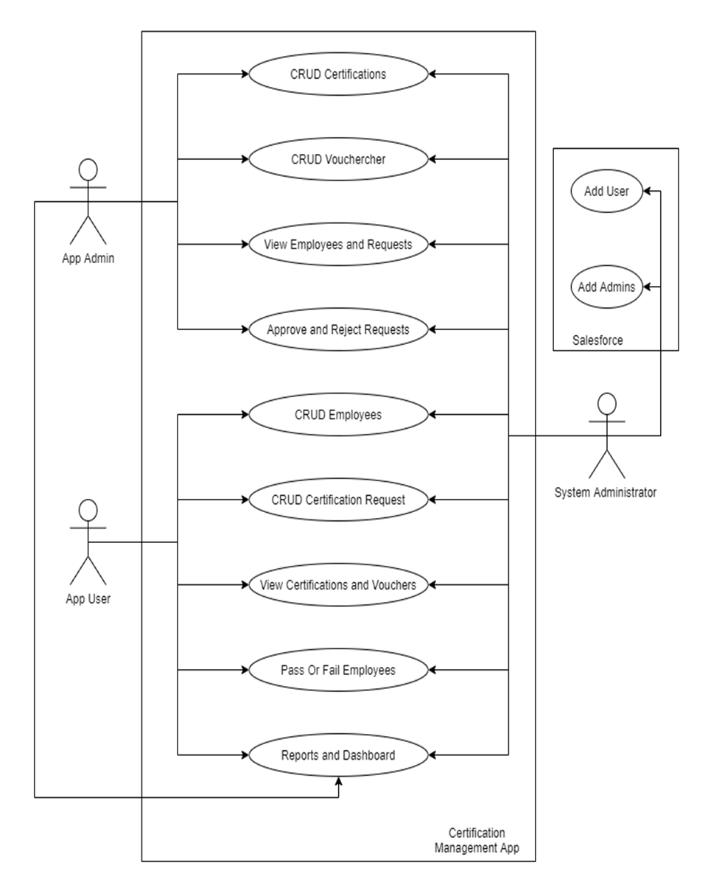
Use Case Diagram:

Slide 8
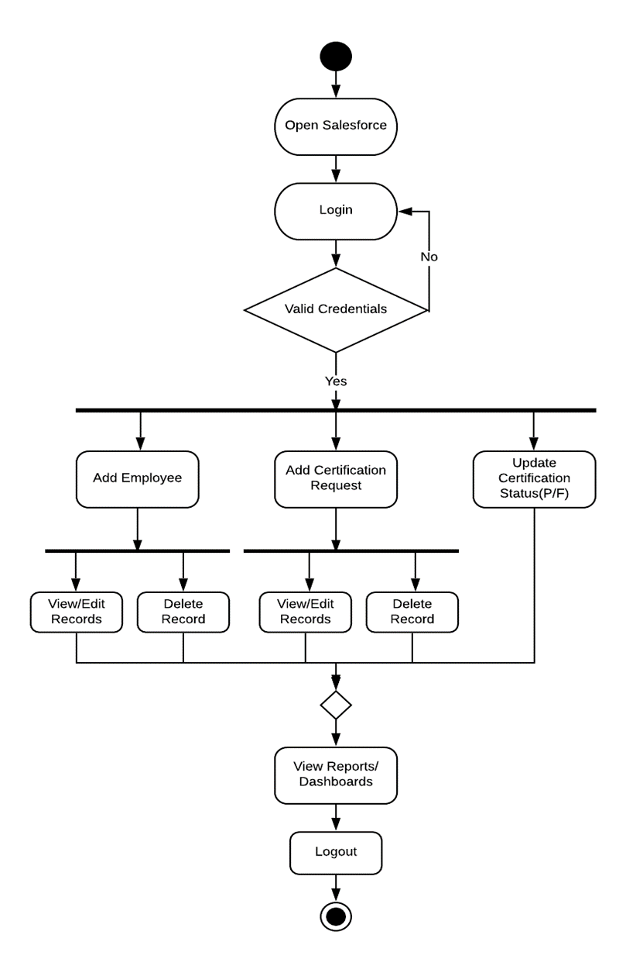
Activity Diagram: (App User)

Slide 9
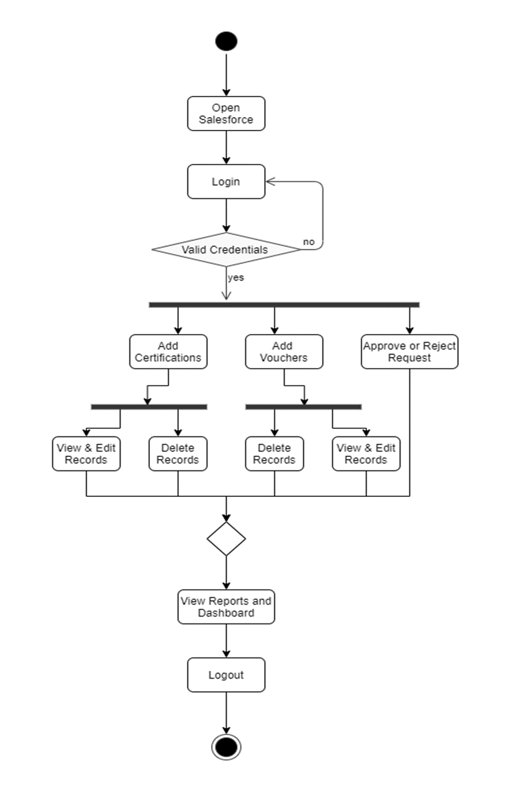
Activity Diagram: (App Admin)

Slide 10
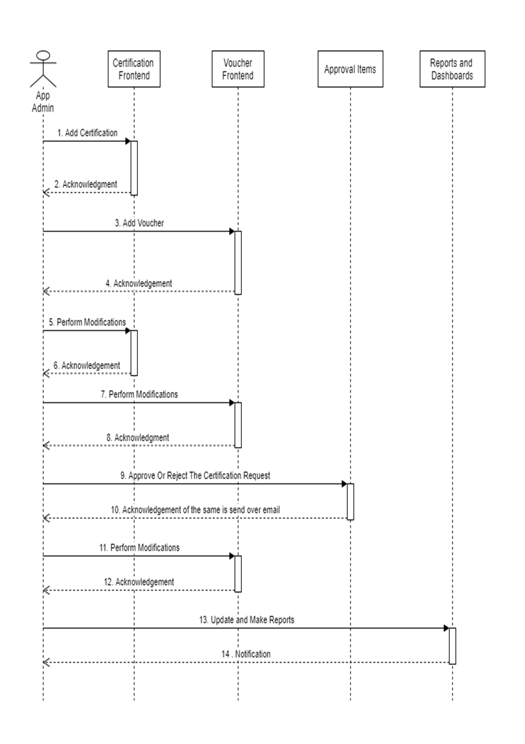
Sequence Diagram: (App Admin)

Slide 11
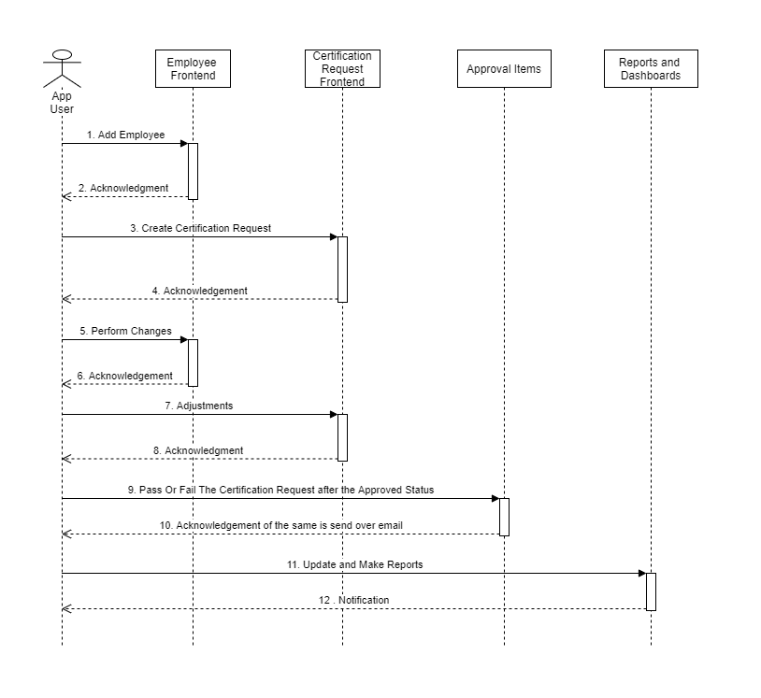
Sequence Diagram: (App User)

Slide 12
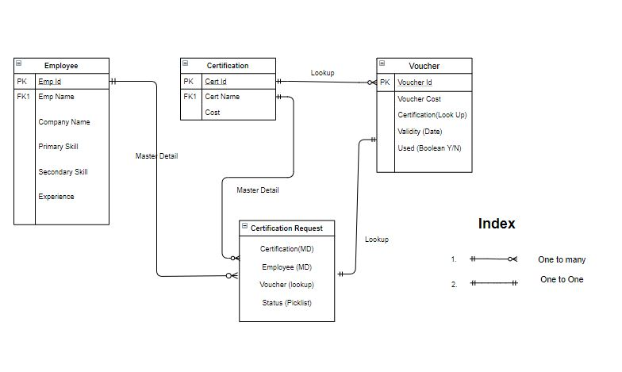
ERD:

